Slide 1
LOCAL FESTIVALS AND CELIBRATIONS
Подготовила
Литовченко Светлана Петровна,
учитель английского языка
МБОУ «Айдарская СОШ им. Б.Г. Кандыбина»
Айдар 2020г.

Slide 2
Региональный компонент к УМК В.П. Кузовлева Английский язык 8 класс. Раздел 2. “Is your country a land of traditions?” Урок 6. “ Are celebrations important?”. Задание 3. In your culture. There are national and local celebrations and festivals in Russia

Slide 3
My small homeland is Belgorod region

Slide 4
Victory Day
Every year Belgorod residents together with the whole of Russia celebrates the 9th of May as a Victory over Fascism and the loss of life during this period of time. As the older generation passes away a new generation will take its place. It is important to remember the past so as to prevent this great tragedy happening again to any country throughout the world

Slide 5
Easter
Easter is a Christian holiday with a long and ancient history. Easter in Belgorod is accompanied by religious services in all Orthodox Cathedrals and churches and Saturday’s processions from the Preobrazhensky Cathedral to the main square in downtown.

Slide 6
Maslenitsa
The celebration of the Maslenitsa holiday dates back to pagan times symbolizing the end of winter and the beginning of spring.

Slide 7
Medieval White City Festival
The festival has been initiated by the Ministry of Culture of the Russian Federation and the Federal Agency for Tourism as part of the Federal Programme “Time to visit Russia”

Slide 8
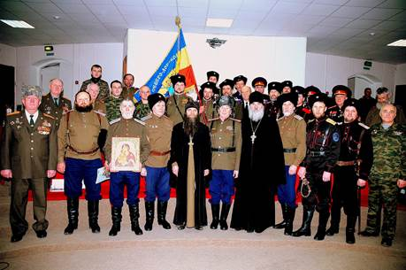
Cossack Culture Festival
The first data about Cossacks on the Belgorod area appeared in 1590. Cossacks defended southern borders of the country and built new countries, for example, Stary Oskol.

Slide 9
Festival of Russian Porridge
«Russian Porridge» is a gastronomic event which annually takes place on the central square of Belgorod – the Victory park, the Museum square.

Slide 10
International Patriotic euro festival ”The Sky Mountains”
Annual festival of ballooning, sport, aviation and sports clubs, held in the city of Belgorod on the Prokhorovka field and in the village of Dubovoye, Belgorod region

Slide 11
International Festival Fair of the Orthodox culture
The International Festival Fair of the Orthodox Culture represents cultural traditions of the Slavic people, their crafts and national ceremonies.

Slide 12
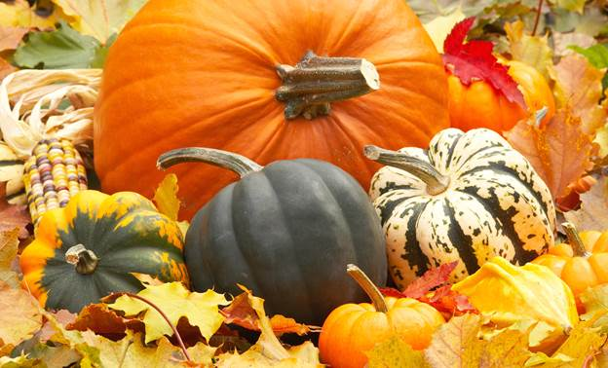
Pumpkin paradise
«Pumpkin paradise» is the branded event firstly taken place On September 23, 2016 on the territory of the Safonovsky settlement Shebekino.More than 200 participants from different regions of Russia and from abroad visit the festival, representing historical reenactment camps of Old Rus, Europe and the Golden Horde.

Slide 13
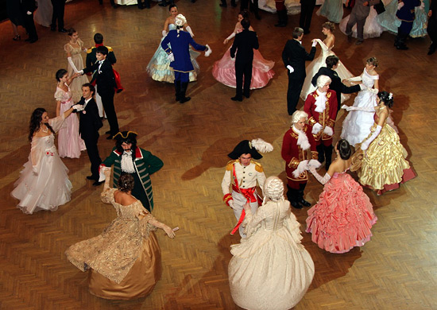
Festival of Russian estate culture ”Usupovskiy meeting”
The festival has been initiated by the Ministry of Culture of the Russian Federation and the Federal Agency for Tourism as part of the Federal Programme «Time to visit Russia»

Slide 14
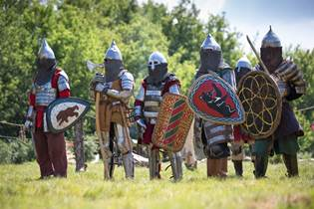
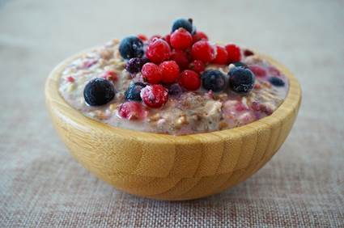
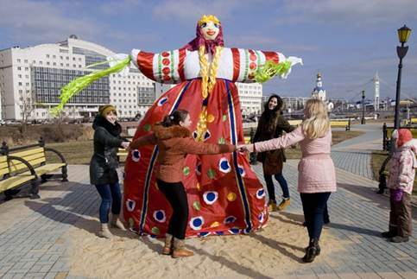
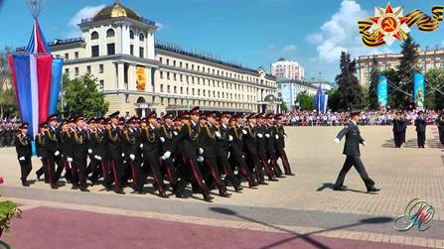
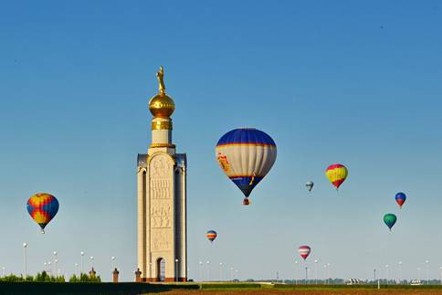
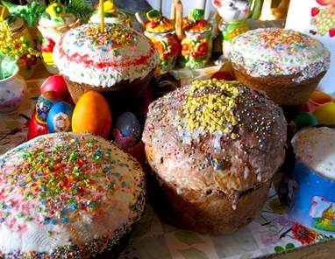
Match the places and the pictures
1.Easter
2. Maslenitsa
3. Pumpkin paradise
4. Medieval White City Festival
5. Cossack Culture Festival
6. Festival of Russian Porridge
7. International Patriotic euro festival “The Sky Mountains”
8. Festival of Russian estate culture ”Usupovskiy meeting”
A
B
C
D
E
F
G
I
H

Slide 15
Homework
What photos will you send to your foreign friend for him/ her to better imagine your area. Explain your choice.
Use http://www.bgunb.ru/links/belogorie_old_and_modern/culture/holidays_&_festivals/english/white_city.pdf

Slide 16
Источники
http://www.bgunb.ru/links/belogorie_old_and_modern/culture/holidays_&_festivals/english/white_city.pdf
http://sitenew.bgunb.ru/Belogorie/Culture.aspx?id=12&lang=1#
http://eventsinrussia.com/en/event/17715
http://paulinrussia.com/All-Seasons-In-Belgorod-2010.php
http://sitenew.bgunb.ru/Belogorie/Culture.aspx?id=12&lang=1#
http://eventsinrussia.com/en/event/17820
http://paulinrussia.com/Maslenitsa-In-Belgorod-2012.php
http://sitenew.bgunb.ru/ProjectsPage.aspx
https://comp-security.net
paulinrussia.com/Easter­In­Belgorod­2012.php
http://www.bgunb.ru/links/belogorie_old_and_modern/culture/holidays_&_festivals/english/victory_day.pdf
paulinrussia.com/Cossack­Culture­Festival­In­Belgorod.php

